Slide 1
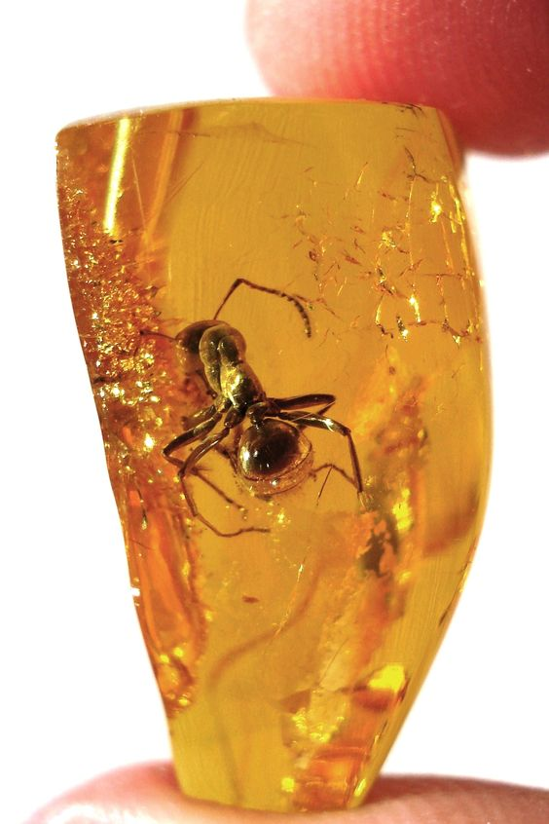
Resins
By
Ass. lec. Riham Adnan Al-Anssari

Slide 2
Resins are
Amorphous mixtures of: essential oils, oxygenated products of terpenes, and carboxylic acids
Plant exudate
Secondary metabolites
Derived from natural living sources, mostly from plants, although some were derived from animal sources like the shellac which is secreted from the lac insect.

Slide 3
Resins properties
Solid, semi-solid or liquid products.
Transparent or translucent products
Soften or melt upon heating
Most of the resins are heavier than water.
They are insoluble in most polar (e.g. Water) and non-polar (e.g. hexan) solvents, but dissolve in alcohol, benzene, chloroform and ethers as well as volatile and fixed oils.

Slide 4
Resins uses
Dragon’s blood has been used as a hemostatic and antidiarrhetic drug.
Myrrh is used as an antiseptic and as an expectorant.
Frankincense has anti-inflammatory properties, and improves digestion.

Slide 5
Resins classification based on their Formation method
1- Physiological resins : formed normally without plant injury.
2-Pathological resins : formed as a result of plant injury or abnormal circumstances.

Slide 6
Classification
1- Based on their formation method: physiological and pathological resins
2-Based on their chemical nature: acid resins (e.g. myrrh), ester resins (e.g. dragon’s blood), alcohol resins(e.g. benzoin), phenol resins (e.g. balsam of tolu), glycoresins (e.g. jalap)and resenes (e.g. asafoetida).
3- Based on the Occurrence with other secondary metabolites: oleoresins(ginger), gum resins, oleo-gum resins(Myrrh), glycol-resins, balsams (balsam of tolu).

Slide 7
Resins classification based on their chemical nature
1-Acid resin : are resineous compounds containing carboxylic acid group (-COOH), a common example is myrrh (commiphoric acid).
2- Ester resin : e.g.benzoin (benzylbenzoate)
3-Resin alcohols: balsam of peru
4-glycosidal resins: jalap resin
5- resene resins: dragon’s blood

Slide 8
Resins classification based on their Occurrence with other secondary metabolites
1- oleoresins : naturally occurring mixture of resins and volatile oils eg ginger
2- gum resins : homogeneous mixture eof gum and resins
3- oleo gum resins: homogeneous mixture of gum, volatile oils and resins eg myrrh
4-glycol-resins :resin combined with sugar via glycosidic linkage
5- balsams : resin with benzoic acid or cinnamic acid either in combination or free.eg balsam of tolu

Slide 9
Resins extraction methods
1-extraction by solvents
2-extraction by distillation
3- extraction by heating resin-containing plant parts
4-extraction by making incisions
5-extraction by incrustation

Slide 10
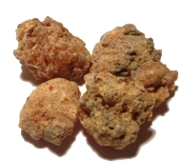
Myrrh
An oleo-gum resin produced by different Commiphora species such as Commiphora myrrh Fam. Burseraceae
Useful part: stem
Extracted by making incisions to the plant stem, the yellow exudates then were allowed to dry to give dark reddish brown resins .
It is used as an antiseptic, astringent, and as an expectorant.

Slide 11
Myrrh
An oleo-gum resin produced by different Commiphora species such as Commiphora myrrh Fam. Burseraceae
Useful part: stem
Extracted by making incisions to the plant stem, the yellow exudates then were allowed to dry to give dark reddish brown resins .
It is used as an antiseptic, astringent, and as an expectorant.

Slide 12
Extraction …. Of what?
1- Extraction with water (water extract is rich in carbohydrates such as arabinose and galactose)
20 gm of myrrh macerated over night with 300 mL water, then filtered.
2- Extraction with alcohol (alcoholic extract is rich with phenolic compounds such as pyrocatechin)
200 gm of myrrh macerated over night with 300 mL methanol, then filtered.

Slide 13
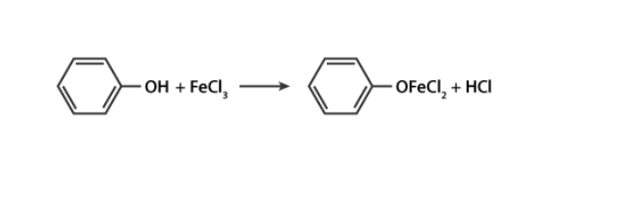
Identification
1- Molish’s test: add 2-3drops of Molisch’s reagent to 1 ml of the water- extract, then add concentrated H2SO4 drop by drop on the side of test tube until purple ring form –this ring indicative of the presence of carbohydrate within the water-extract of Myrrh resin.
2-FeCl3 test: few drops of 1% FeCl3 solution added to 1 mL of alcoholic-myrrh extract, shake well then leave it to stand for a while, a light brown precipitate formed due to the presence of phenolic compounds within the alcoholic extract of Myrrh resin.
Responsible for the color change and/or formation of precipitate

Slide 16
In Whole or in pieces
Get the bug out of the amber !
Home work

